Slide 1
CMS OIT Human-Centered Design Oral Briefing
June 20, 2019
Jordan Watts
Amanda Mancuso
Tyler Bolchoz

Slide 2
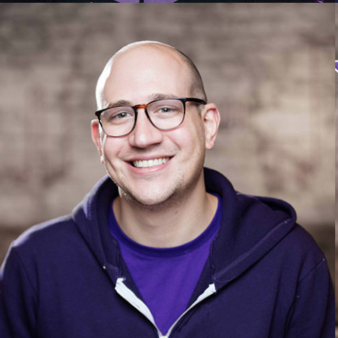
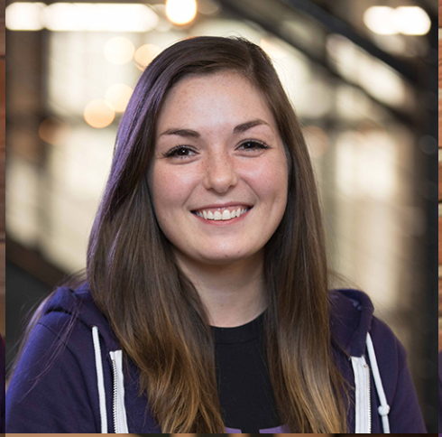

Introductions
Jordan Watts,
UX Coach
Amanda Mancuso,
UX Designer
Tyler Bolchoz,
Product Designer
Notes:
Jordan

Slide 3
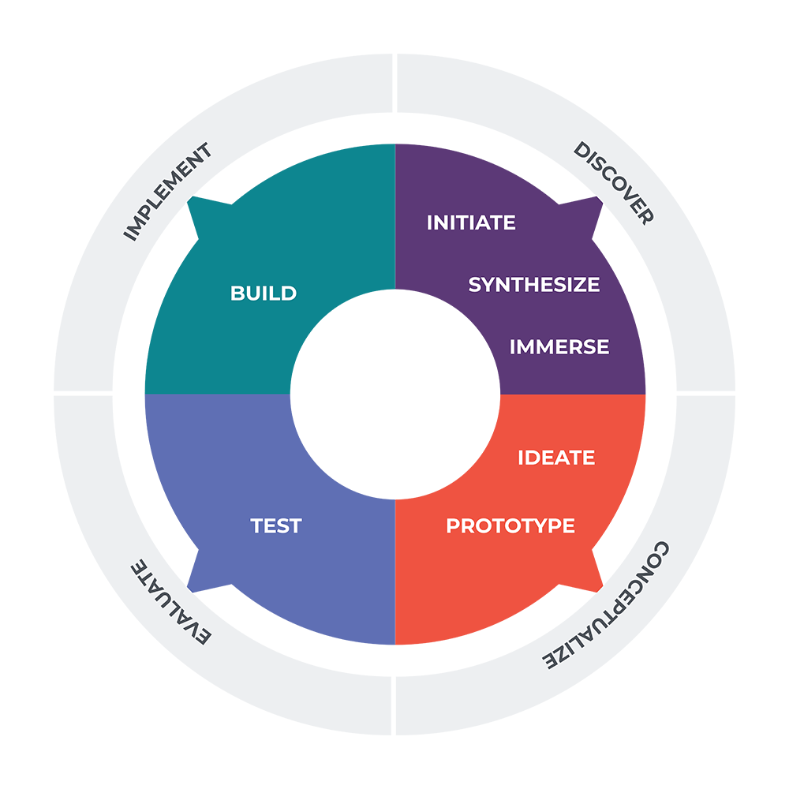
Project overview
Notes:
Jordan
What it is: The CMS HCD process -- the use case was to design an amazon-like platform for IT procurement.
Why we did it: To align the CMS model with our existing design practice. To set the stage for iterative delivery.
How we did it: Working sessions over 4 days
Outcome: An MVP for both the IT product catalog and procurement process

Slide 4

Immerse
Empathy map
Interviews
Competitor analysis
Notes:
Maximized time

Slide 5
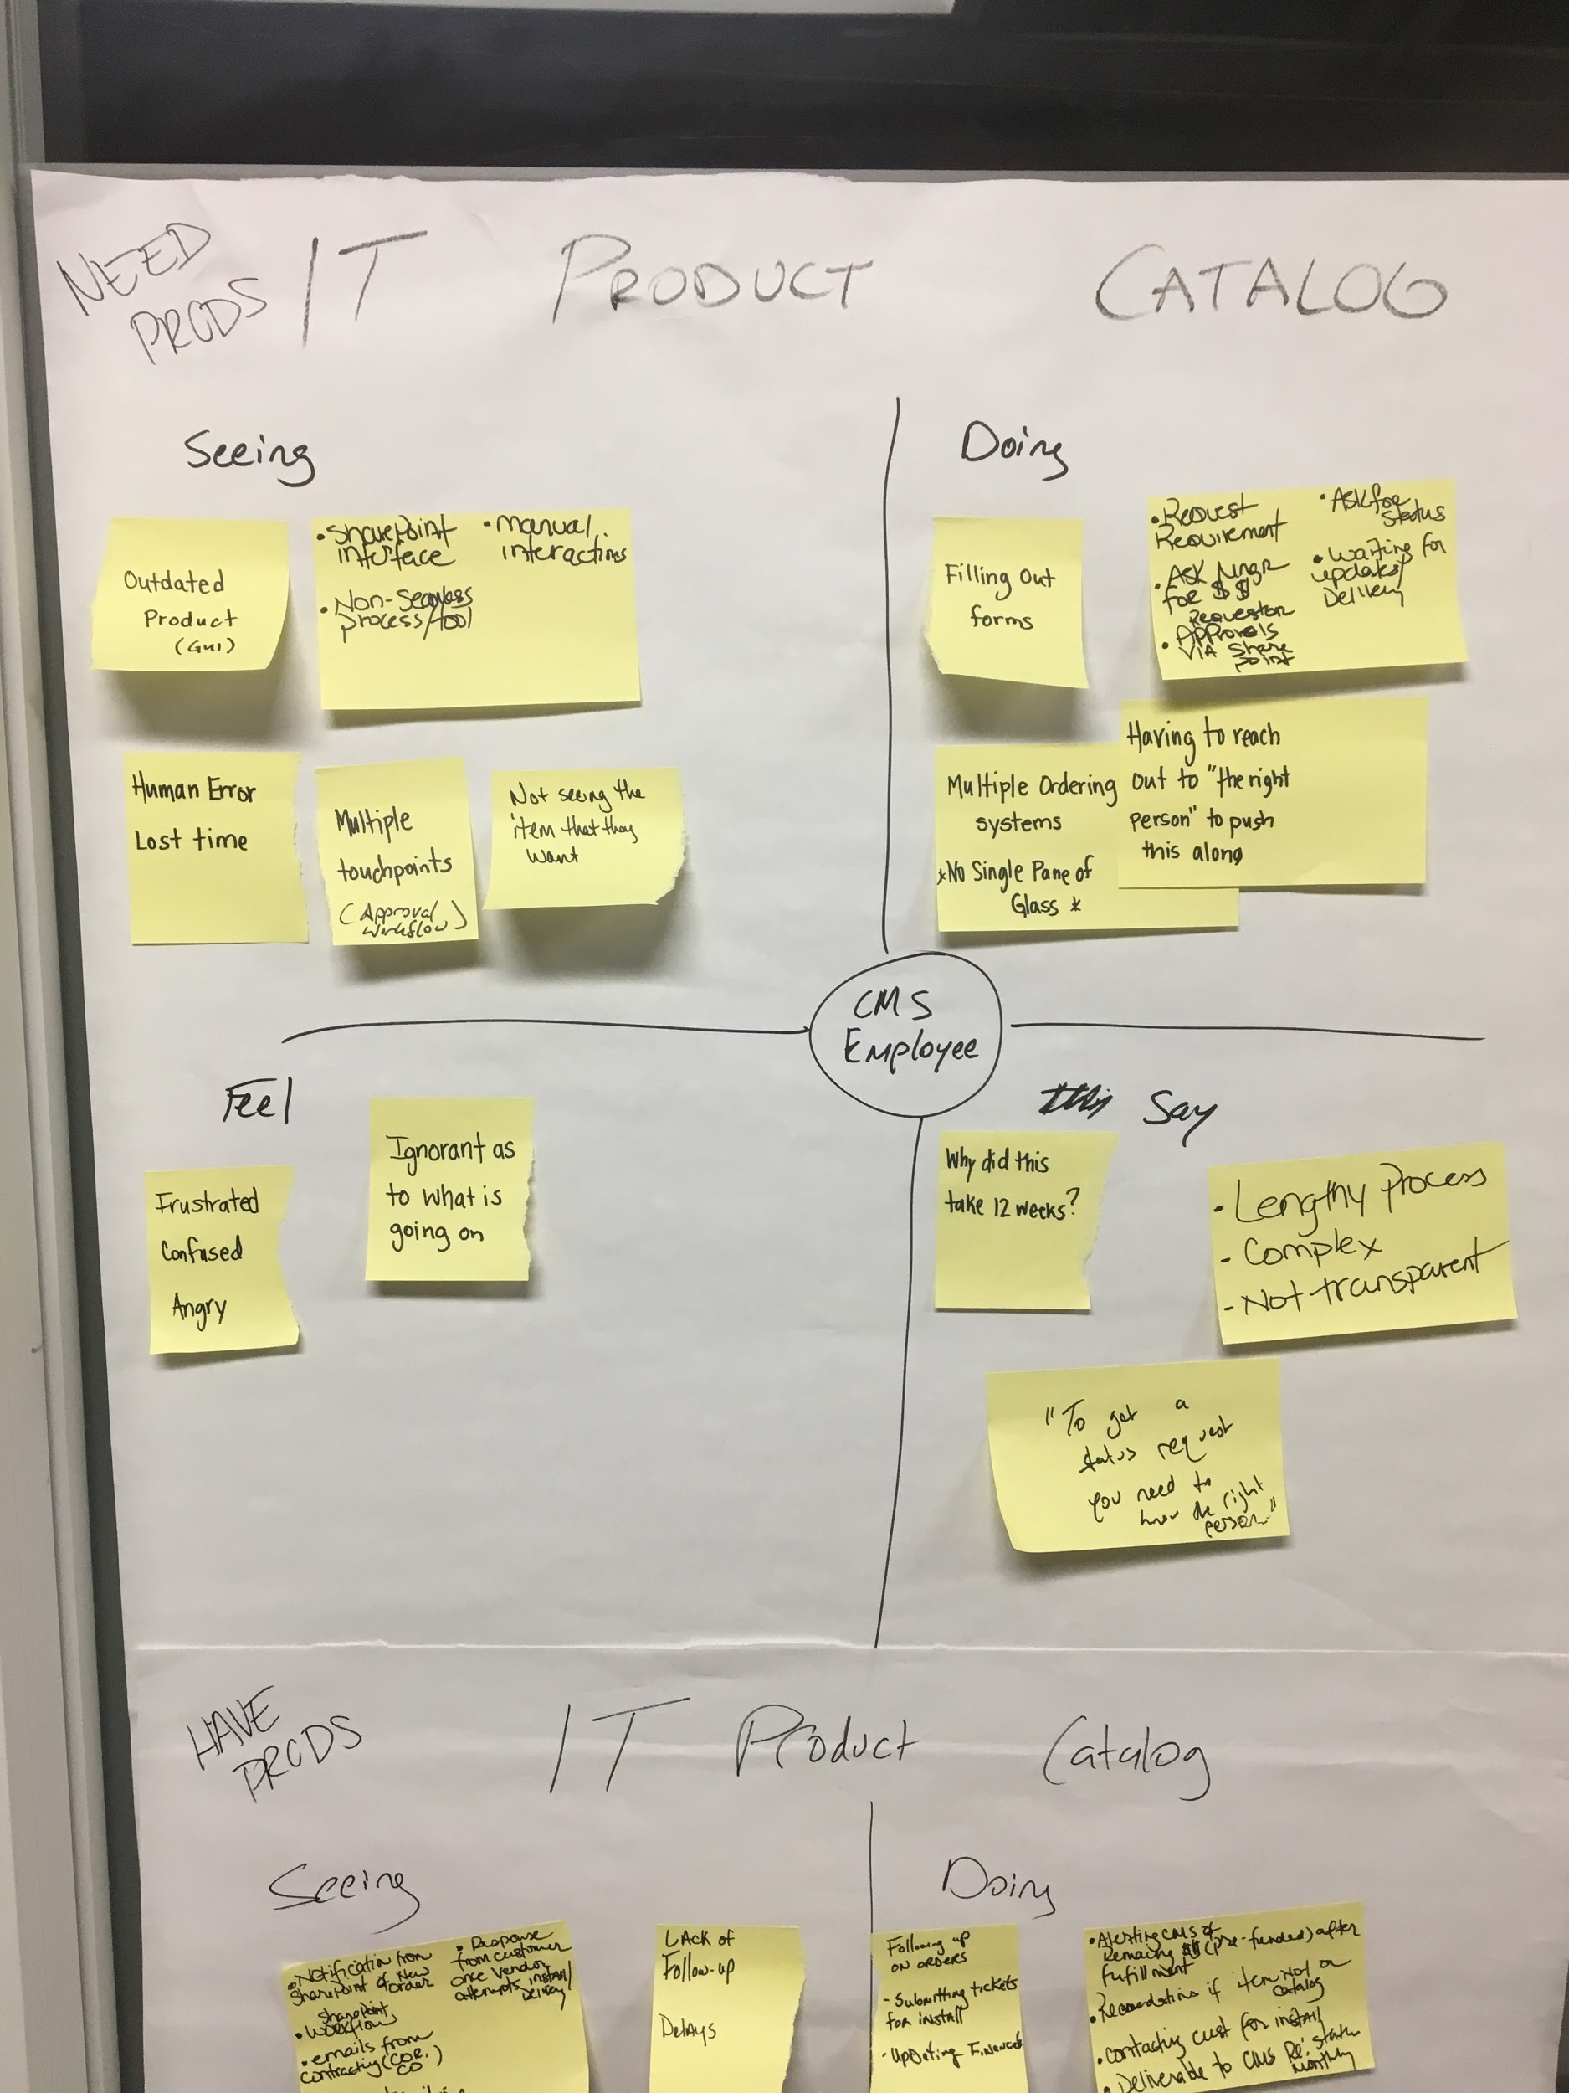
Empathy map CMS employee
Notes:
Jordan
What it is: Collaborative tool for understanding people’s mindset and behaviour.
Why we did it: To better understand the people we’re designing for.
How we did it: Identified users then populated the chart.
Outcome: Better understanding of who the users are. Learned how frustrated everyone is with current process.

Slide 6
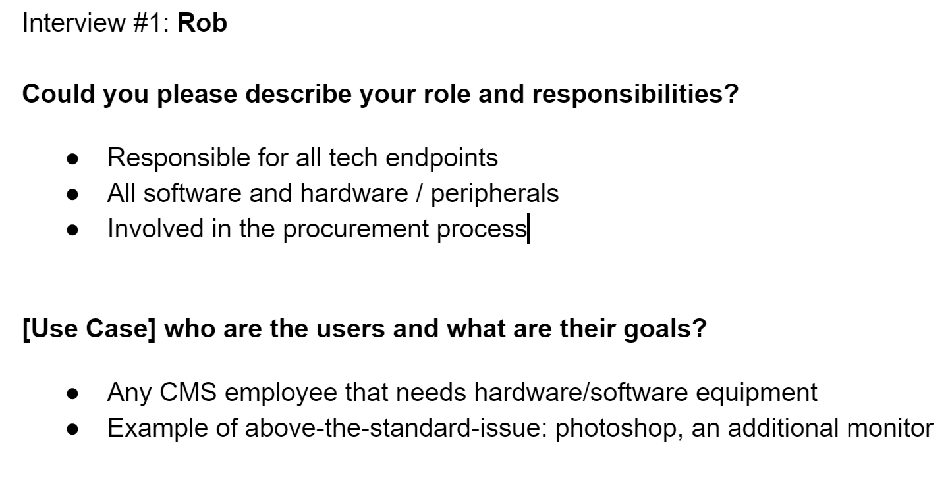
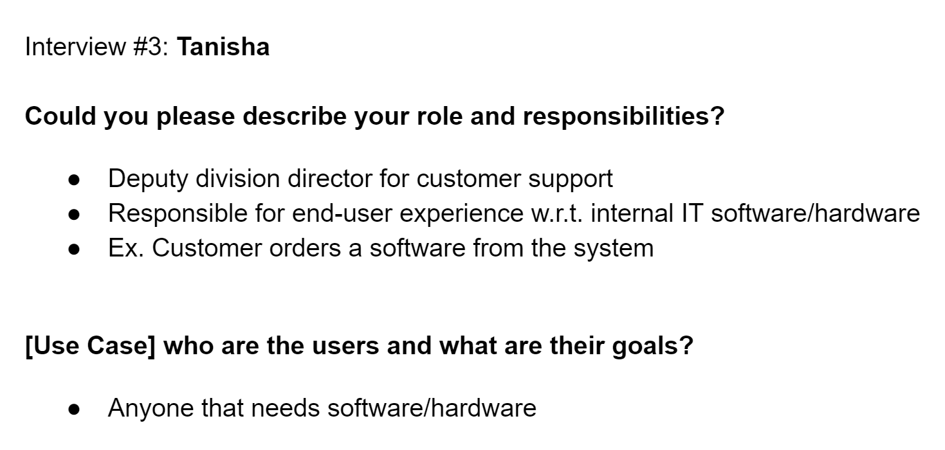
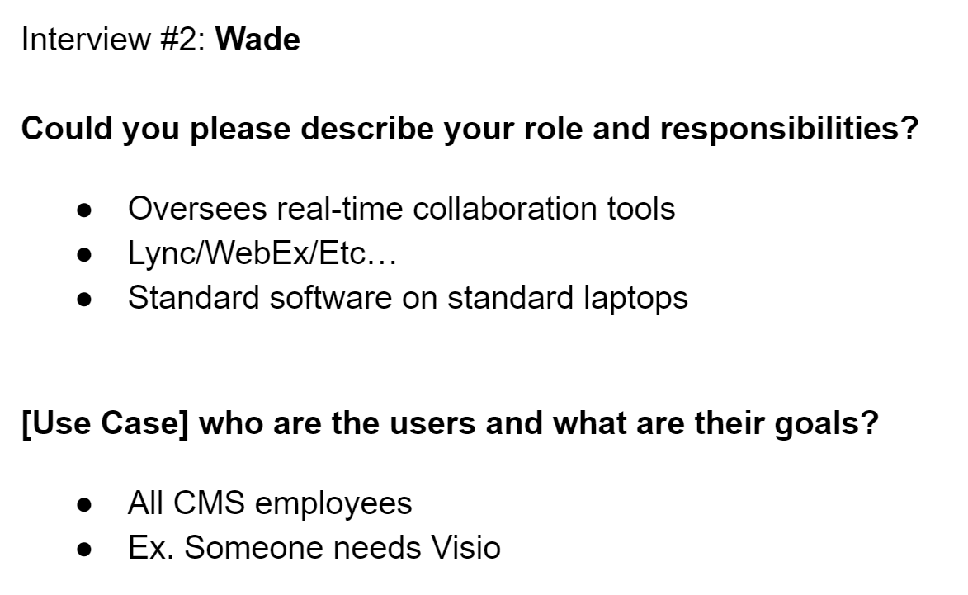

Interviews
Notes:
Amanda
What it is: Conversation with users
Why we did it: Understand who they are, the current process, and their pain points
How we did it: Prepared a script of standard questions, 10 minute 1v1 interviews
Outcome: Average CMS employees didn’t know how to start a procurement request, lacks transparency, and CMS has been actively trying to fix this problem with Sharepoint and ServiceNow.
Didn’t feel like we got enough information in the short 10 minute interviews, so we continue to talk to our partners to learn more details. Where we learned more about the current process and the limitations of Service Now

Slide 7
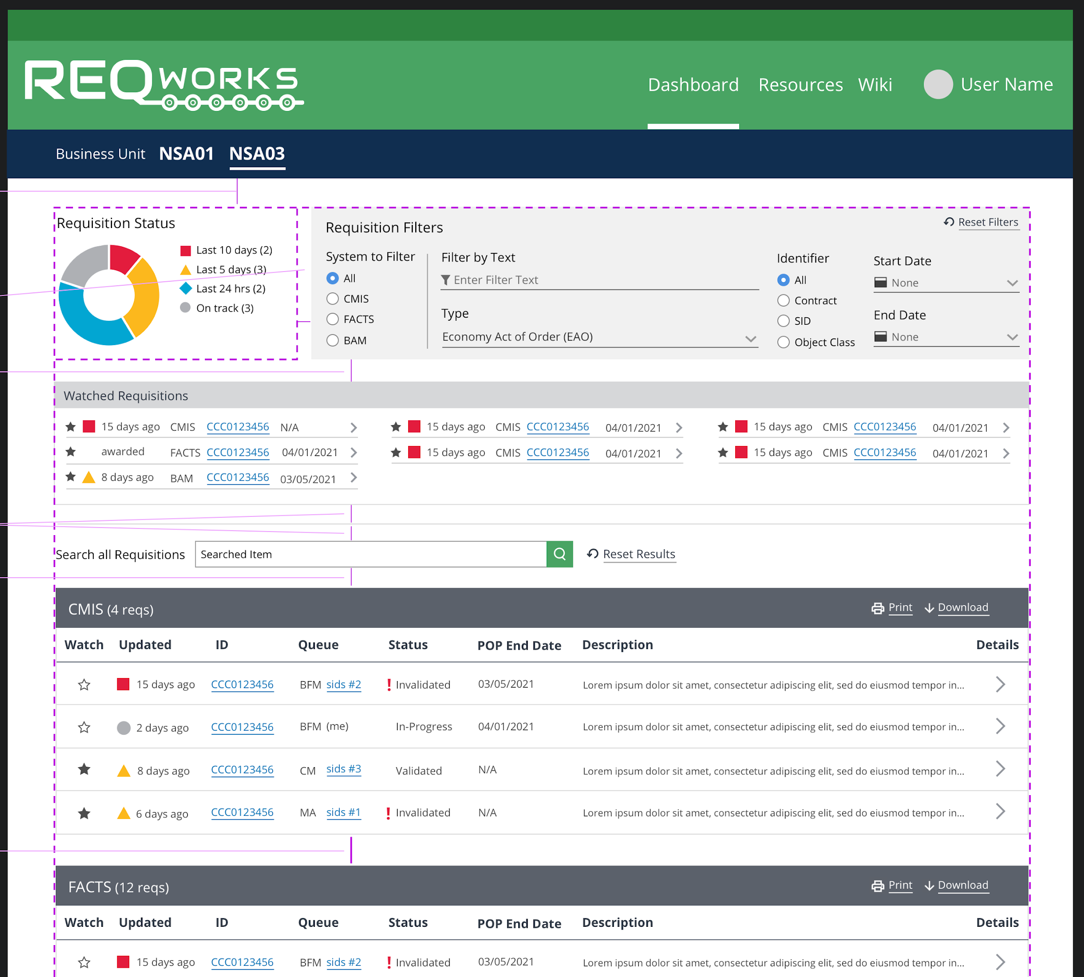
Competitor analysis
Notes:
Tyler
What it is: Looking at existing products as a sort of “solution landscape”
Why we did it: To see how similar problems/use cases have been solved
How we did it: Fortunately, an internal team at fearless is working on a very similar use case, so we met with them
Outcome: Learned some good patterns and challenges of the workflow. Learned that a nice UI alone won’t solve institutional issues.

Slide 8

Synthesize
Interview synthesis
“How Might We?” statements
Proto-personas
Design hypotheses
Minimum Viable Product list
Notes:
Jordan

Slide 9
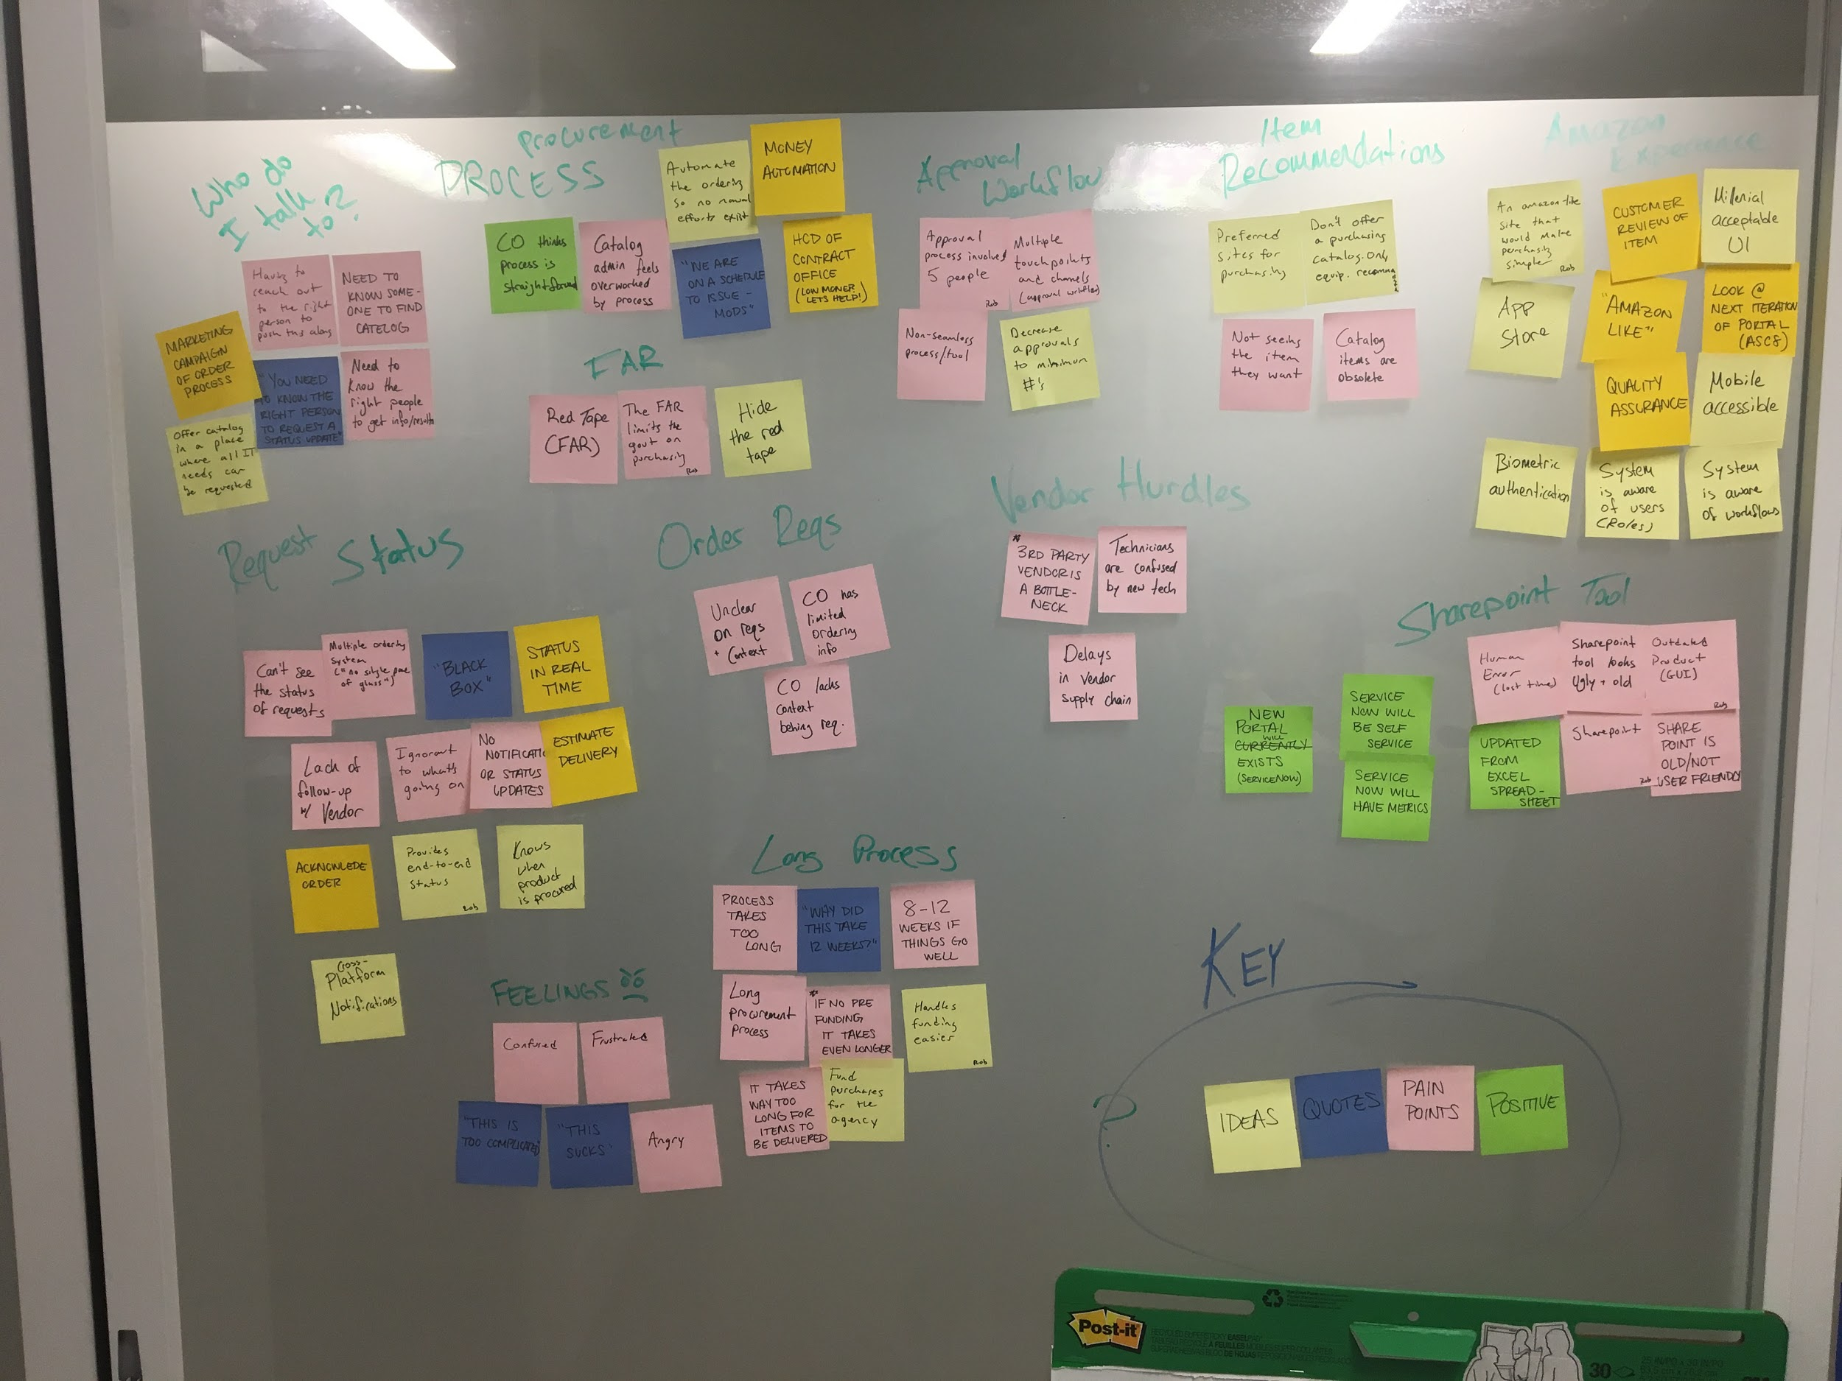
Interview synthesis working session
Notes:
Amanda
What it is: Synthesis data gathered to from interviews
Why we did it: Find patterns through various research techniques
How we did it:
Primed notes (highlighting)
Externalizing what we heard (sticky notes)
Organizing information (round 1),
Refine topics in to meaningful insights (round 2)
Outcome:
Identify true meaning from patterns (used for decision-making, communicating shared understanding, and define complex ecosystems
Example- Frustration specifically with how long the process is
Reference from Cooper Design Research Methods Class

Slide 10
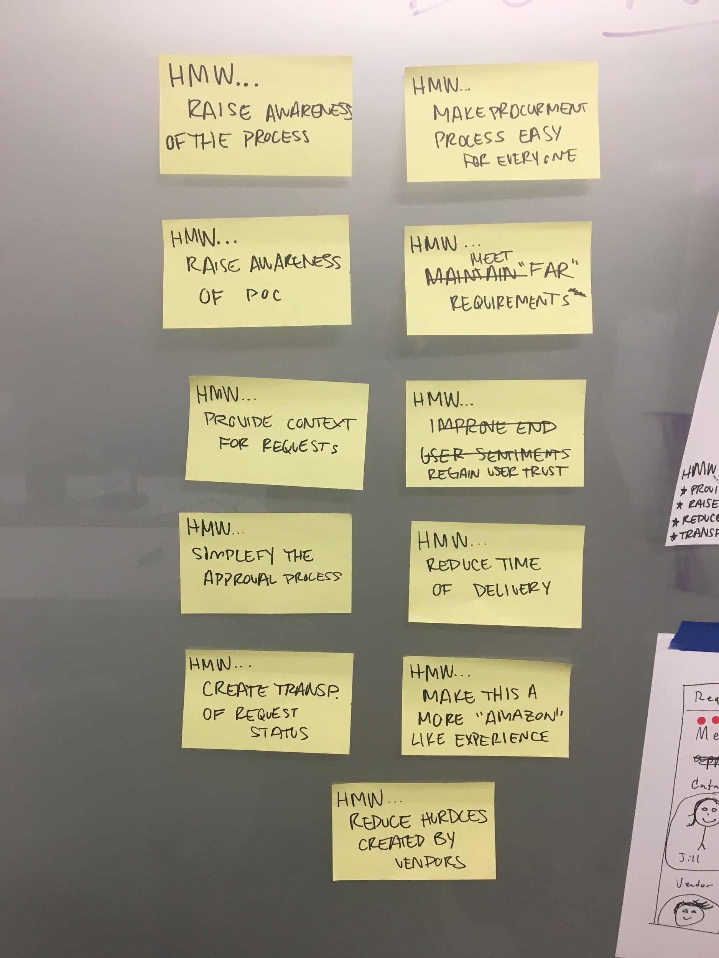
“How Might We?” statements
Notes:
Amanda
What it is: Translating problems into opportunities > “HMW simplify the approval process”
Why we did it: Find design opportunities
Outcome: Find opportunities for design

Slide 11
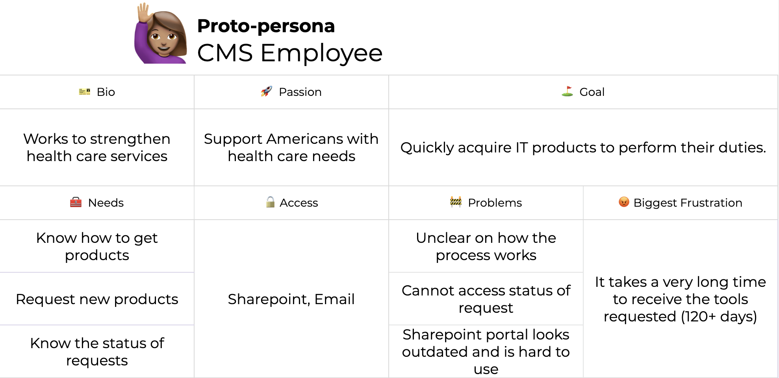
Proto-personas Google sheets link
Notes:
Amanda
What it is: Quick personas based on the assumptions of the stakeholders
Why we did it: Didn’t have access to some users like the vendor, but still wanted to understand key characteristics
How we did it: Referencing the synthesis notes and empathy maps
Outcome: 4 proto-prsonas

Slide 12
Design Hypotheses
An Amazon-like platform will reduce the time it takes to request and approve procurement to 2 days.
A technology solution alone will not reduce the time it takes to request and approve procurement.
Orchestration of procurement front- and back-stage actors, processes, and platforms will reduce the average procurement timeline.
Knowing the status of requests will reduce confusion around the procurement process.
Knowing the proper point of contact for each stage of the procurement process will reduce confusion.
Recommending alternate items or vendors will increase the speed of procurement when a requested item is unavailable.
Notes:
Jordan
What it is: Assumptions about the current problem and possible solutions.
Why we did it: To test and learn so that we can make informed decisions about next steps.
How we did it: Analyzed the patterns in from our research and ideation methods. This is not a linear process.
Outcome: Prioritized the best candidates for MVP based on the use case and deadline.

Slide 13
MVP 1: IT product catalog
Persona: CMS employee (Requester)
Needs: A second monitor for their workstation.
Wants: To use the platform to check the status of their request.
Values: Greater transparency into the status of procurements.
Artifacts: Proto-personas, user flows, clickable prototype, usability test script
Notes:
Jordan
What it is: A solution that will satisfy the CMS employee’s needs.
Why we did it: To communicate an iteration that can be tested.
How we did it: Chosen based on our hypothesis list.
Outcome: Review MVP

Slide 14
MVP 2: IT procurement Service Blueprint
Persona: Catalogue admin
Needs: More seamless orchestration of procurement processes and staff.
Wants: A new procurement process and platform.
Values: Fewer obstacles to providing CMS staff the equipment they need.
Artifacts: Proto-personas, service blueprint
Notes:
Jordan

Slide 15

Ideate
Crazy 8’s
User flows
User journey map
Service blueprint
Notes:
Jordan

Slide 16
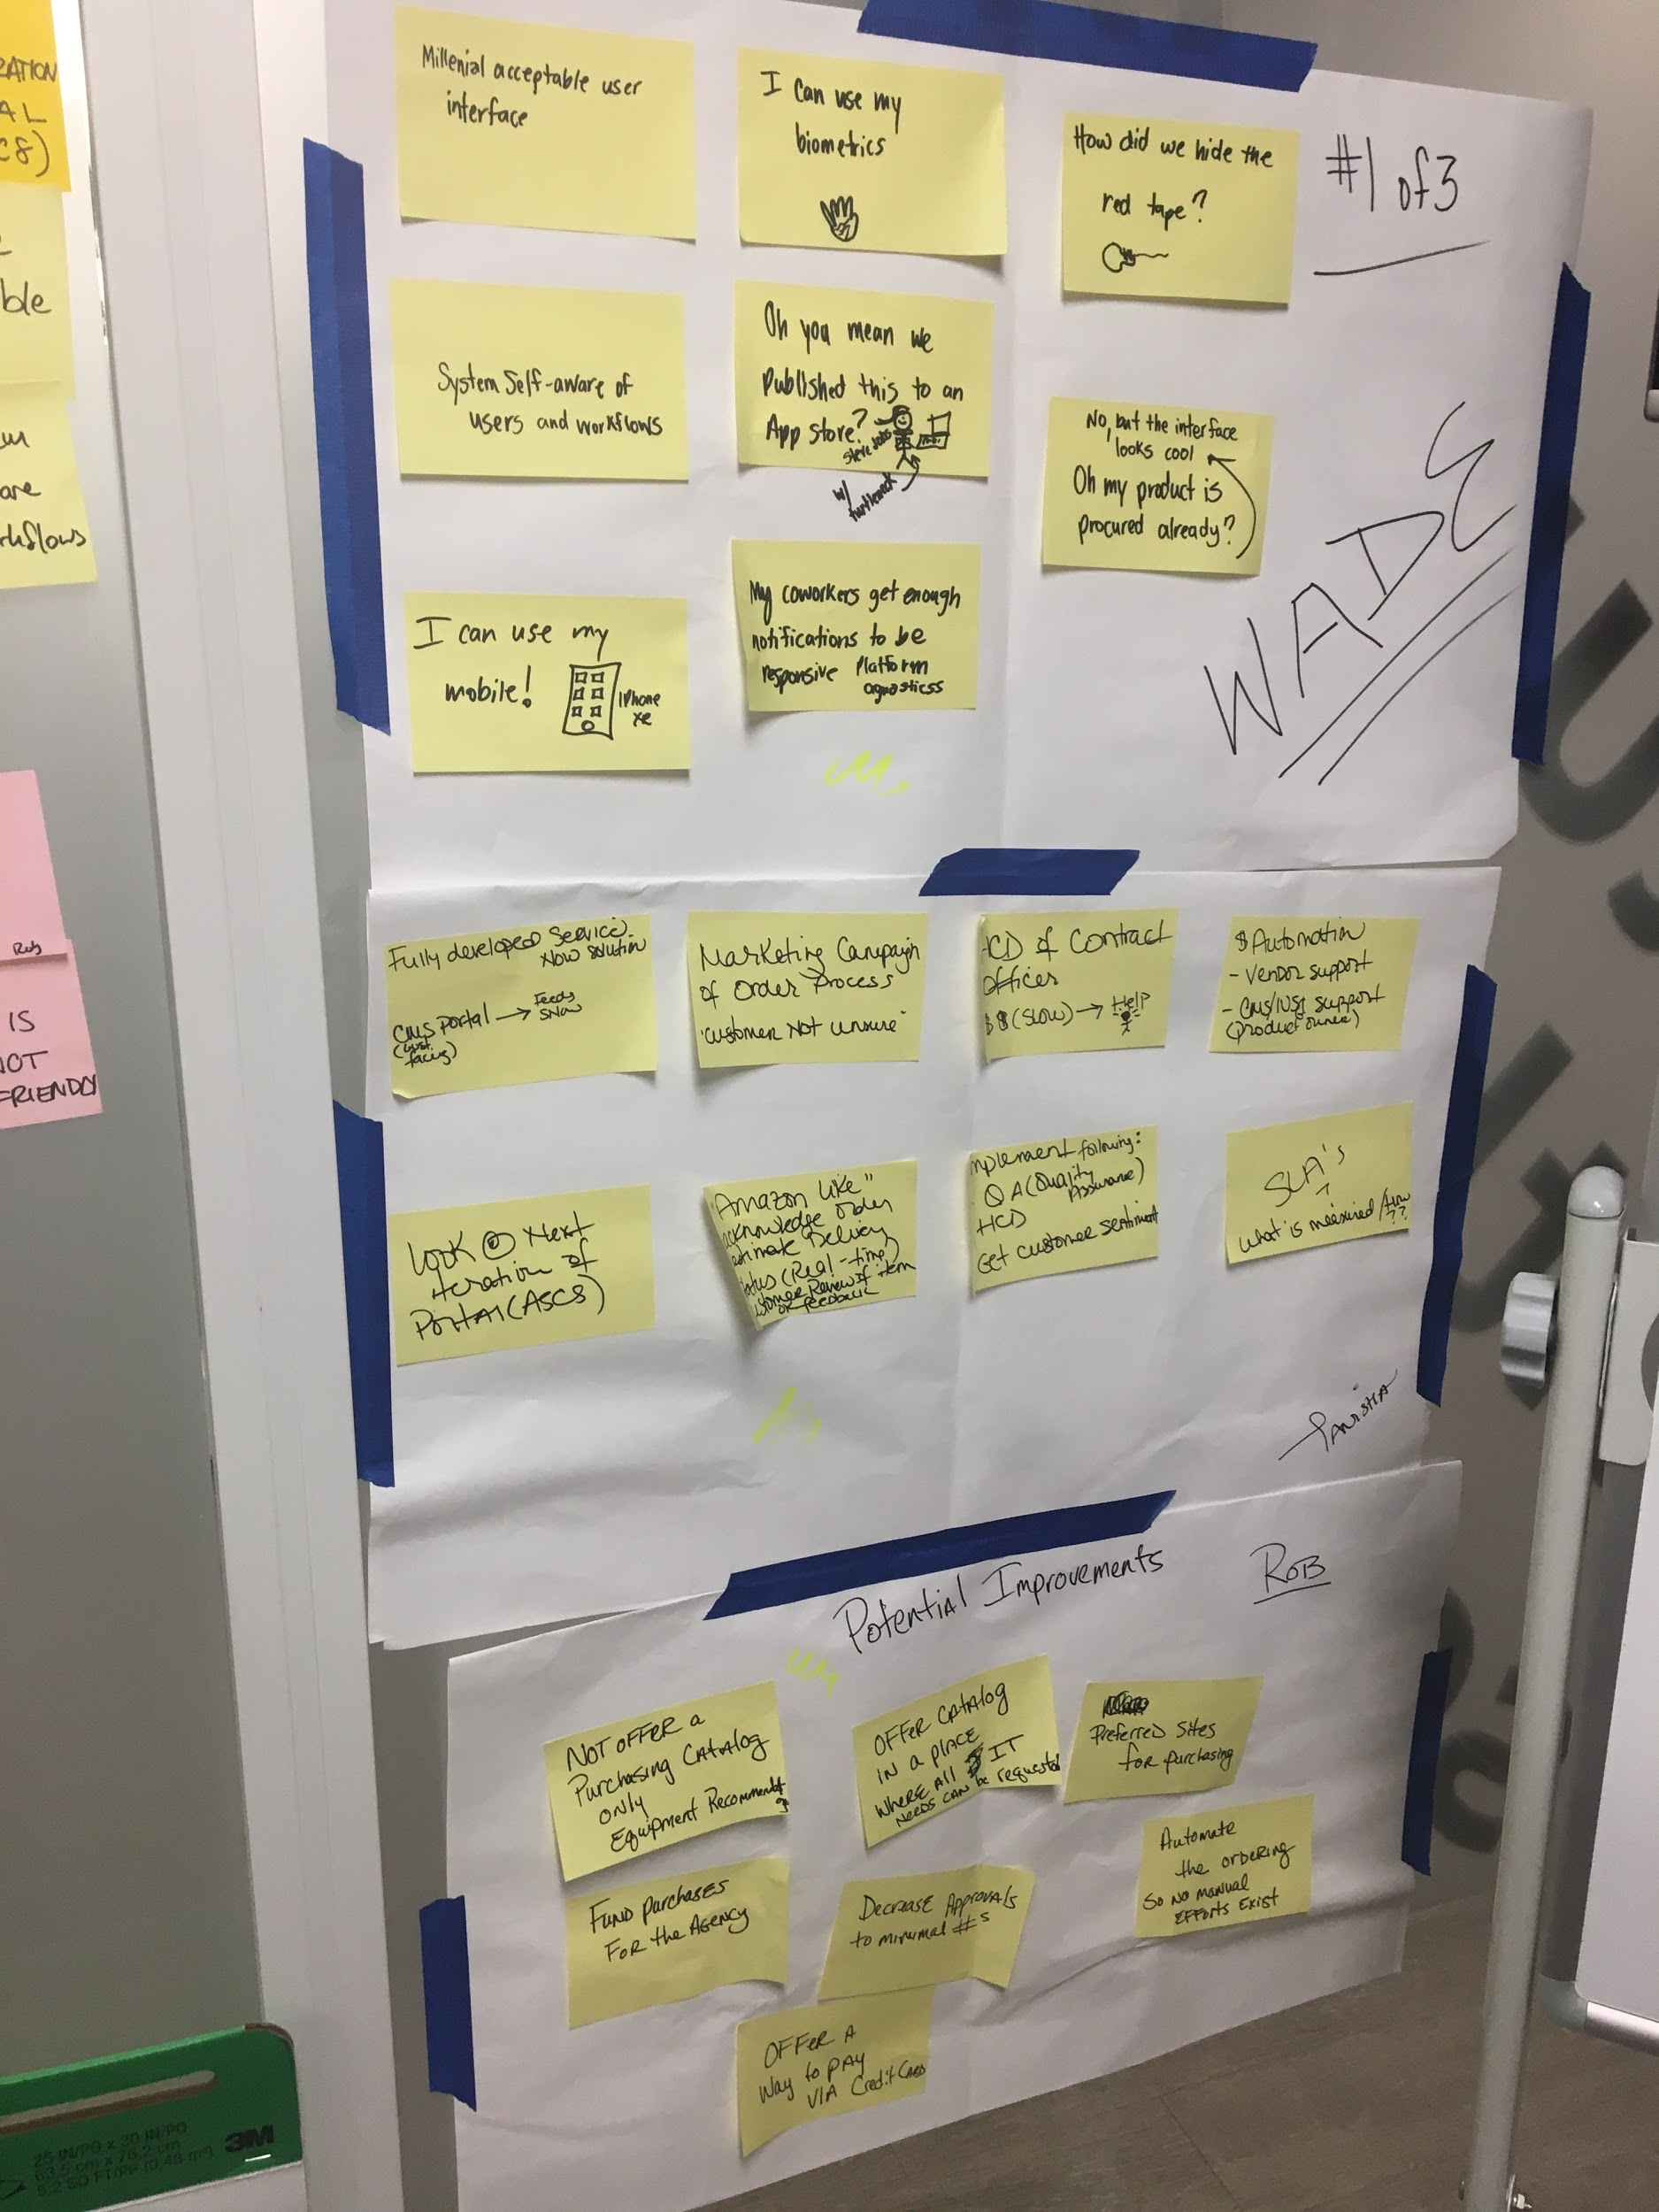
Crazy 8’s Co-creation session
Notes:
Jordan
What it is:
Why we did it:
How we did it:
Outcome:

Slide 17
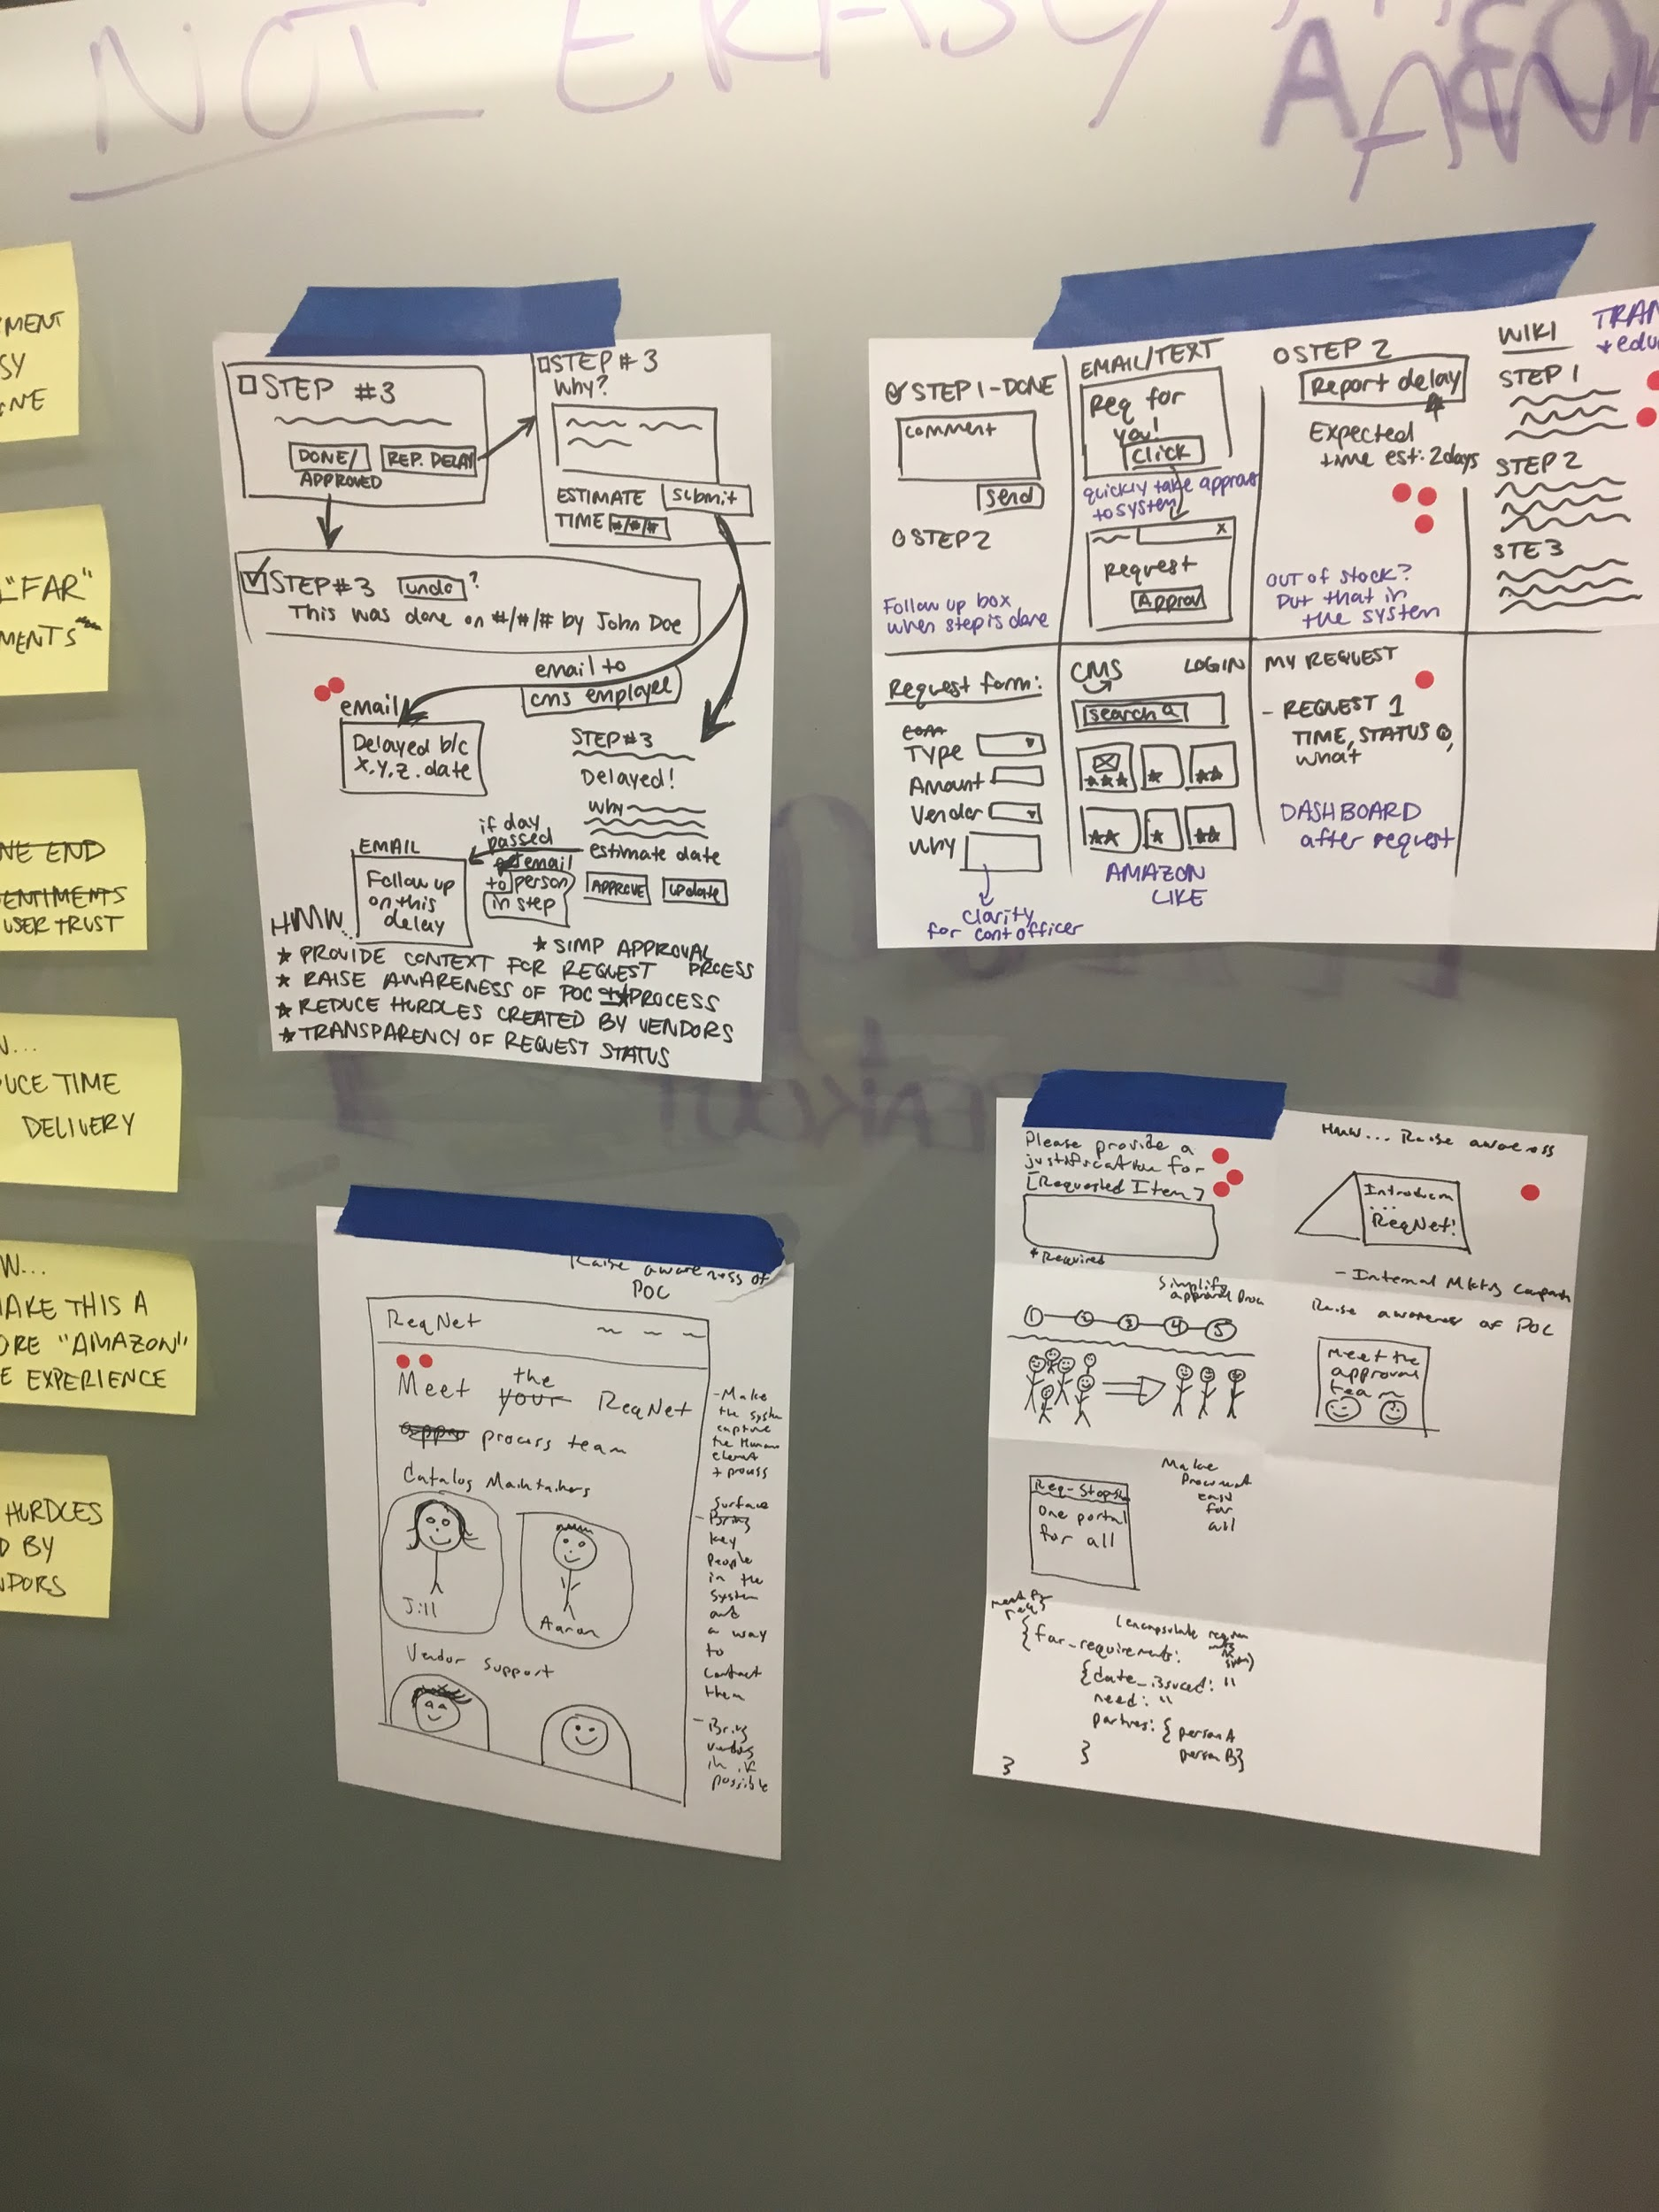
Crazy 8’s Design team working session
Notes:
Jordan
What it is:
Why we did it:
How we did it:
Outcome:

Slide 18
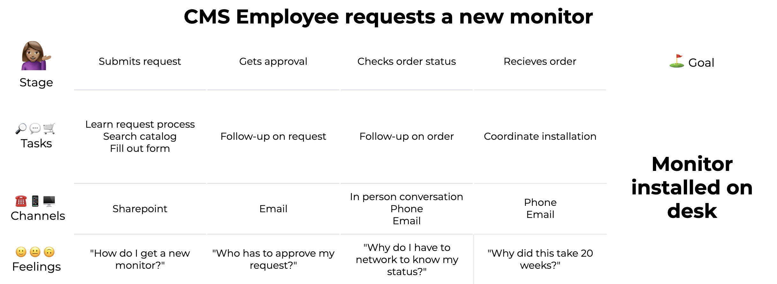
User Journey Map
Notes:
Amanda
What it is: Visually shows the users flow
Why we did it: Wanted to understand the current process, what tasks and channels a user interacts with, and how they feel at each stage
How we did it: Referencing the synthesis notes and empathy maps
Outcome: Complete user journey map the CMS Employee currently takes

Slide 19

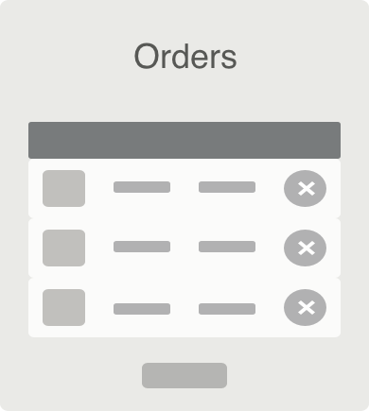
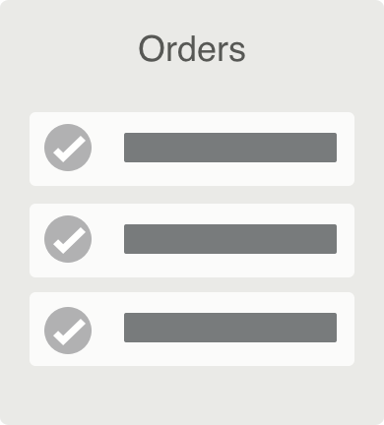
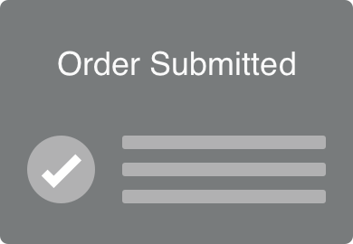
Primary User Flow 1
CMS Employee
“I want to know when my extra monitor will arrive.”
Verify Request Submitted
Checks Approval Status
Checks Arrival Status
Checks Delivery Status
Does
Sees
Confirmation Email
Approval Email
Orders Page
Orders Page
Notes:
Tyler
What it is: Sort of like a storyboard. This helps us start to think about the major milestones a user would take to reach a goal
Why we did it: Helps narrow down to key steps that can be iterated on, evaluated, socialized, etc.
How we did it: We worked on trying to slice a small piece of the overall journey map
Outcome: Tangible flows to meet a task/goal. Theme emerged that an Orders Page would be useful

Slide 20
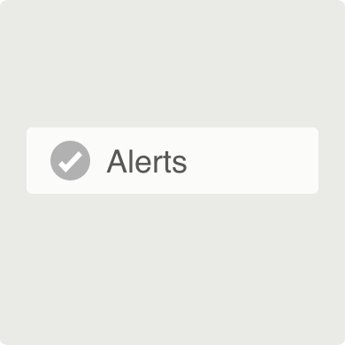
Primary User Flow 2
CMS Employee
“I want to be alerted on the status of my monitor request.”
Does
Searches for Order
Clicks “View Orders” Link
Finds Order
Turns on Status Change Alerts
Sees
Confirmation Email
Confirmation Email
Orders Page
Order Alerts
Notes:
Tyler
What it is:
Why we did it:
How we did it:
Outcome:

Slide 21
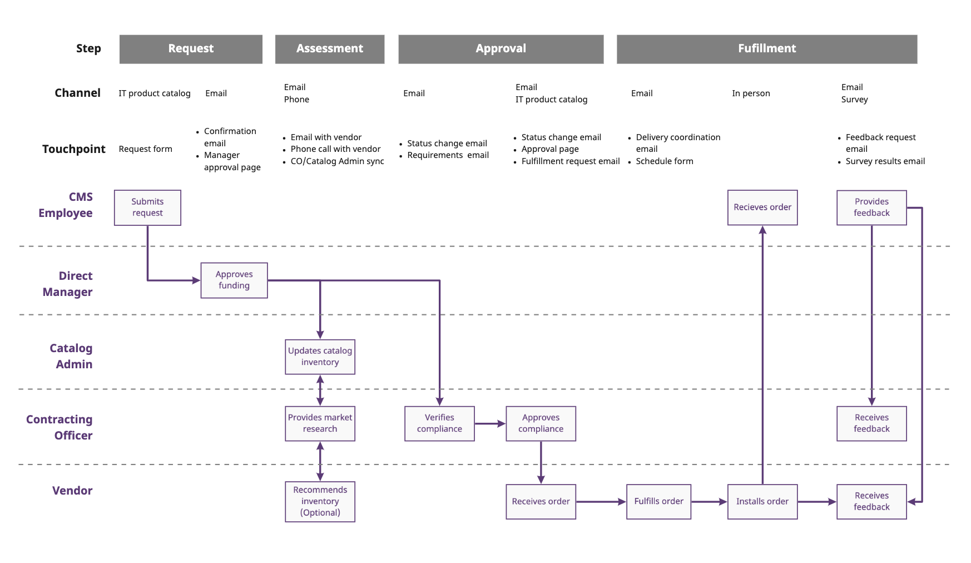
Service Blueprint Miro link
Notes:
Amanda
What it is: Diagram that shows the relationships between different people and processes
Why we did it: Solution for Hypothesis 2 = streamline the process
Adding automation for catalog maintenance
Encouraging collaboration between catalog admin, contracting officers, and vendors to help with transparency
How we did it: Brainstorm ideas

Slide 22

Prototype
Wireframes
Clickable prototype
Notes:
Jordan

Slide 23
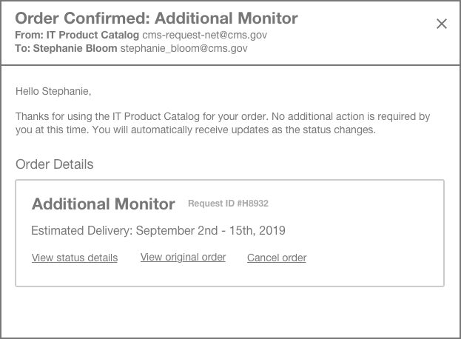
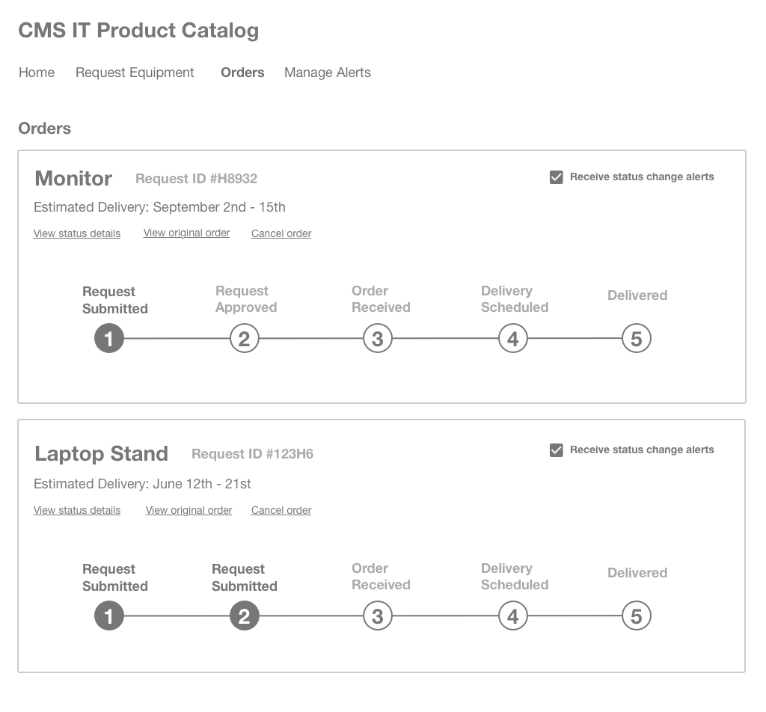
Wireframes and clickable prototype Invision link
Notes:
Tyler
What it is: Crude representation of some potential screens
Why we did it: Developed based on patterns from user flows
How we did it: Rough sketching in digital tools like sketch. Clickable in invision
Outcome: Good communication tool for conveying an idea of a system

Slide 24

Test
Usability study
Alignment workshops
Notes:
Jordan
What it is:
Why we did it:
How we did it:
Outcome:

Slide 25

Build
Service delivery pilot
Catalog prototype
Notes:
Jordan

Slide 26

Suggestions for Future Projects
Start with questions,
not solutions
Build in time for discovery
Provide designers access
to a variety of stakeholders
Prioritize iterative design
Notes:
The oral presentation process = waterfall
How you ask the question dictates the solution
HCD is about figuring out what doesn’t work

Slide 27
Questions?

Slide 28
Backup slides

Slide 29

User research
Notes:
User Research
User interviews (personas and journey map content--these things are products of user interviews) \o/
Participatory and iterative design activities (slides from Kelsey’s design sprint content)
Hypotheses testing (lean UX slide)
Usability testing (pipeline from user to implementation)

Slide 30
Steps for actionable research
Decide on a research goal and method
Recruit relevant participants
Practice running the session
Capture insights so they can be easily shared
Add opportunities and pain points to your backlog
Notes:
Come up with a plan. Determine the goal of the study, define what you’re trying to understand, and identify participants.
Recruit real people. Schedule participants using an automated workflow or use methods like guerrilla recruiting to get in front of users.
Do the prep work. Write a list of questions, set up any necessary technology, and (if the study is in person) prepare the setting.
Conduct the interview!
Create research artifacts based on findings. These include deliverables such as journey maps and user personas.

Slide 31
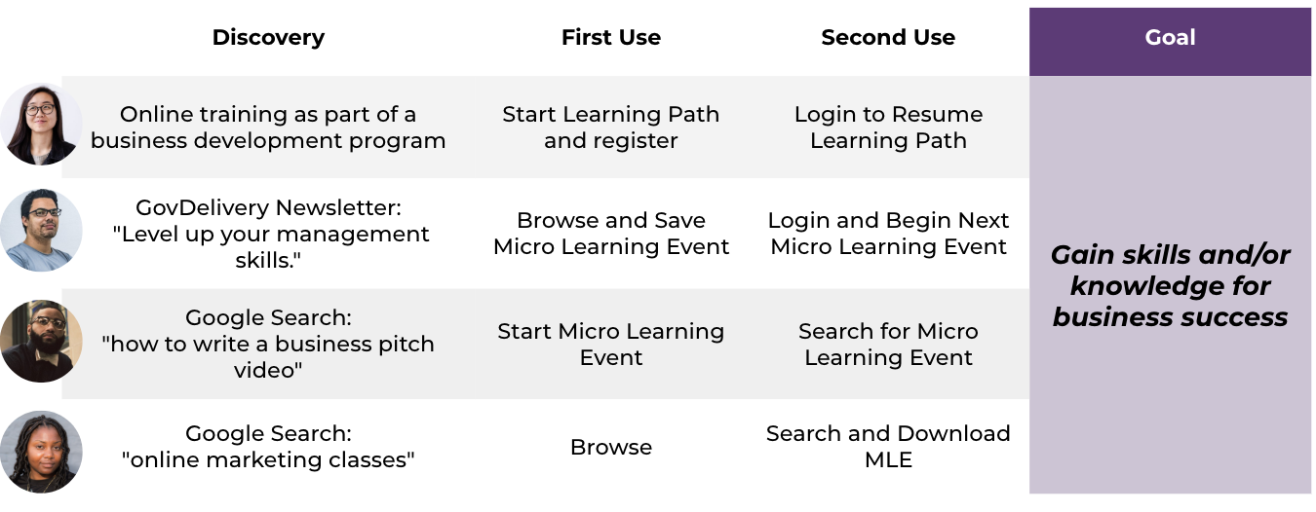
Journey maps

Slide 32
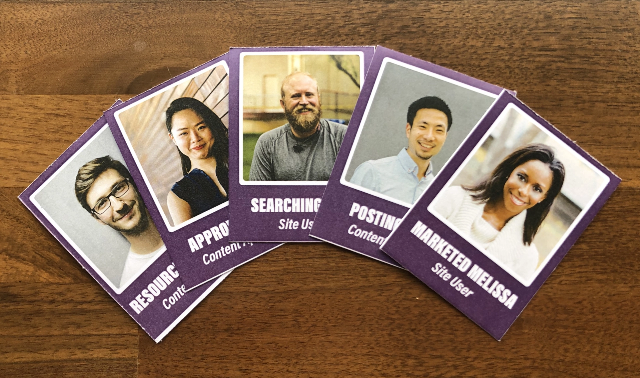
Get more from your research
Use a mix of quantitative
and qualitative methods
Pick a screening process
Automate scheduling
Make insights easy to find
Offer participant incentives
Select the right number of participants for your needs

Slide 33
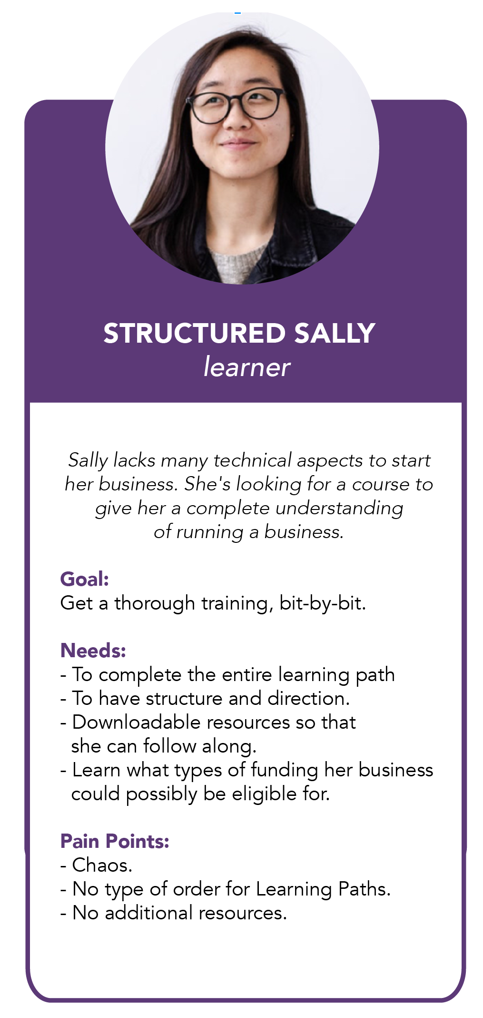
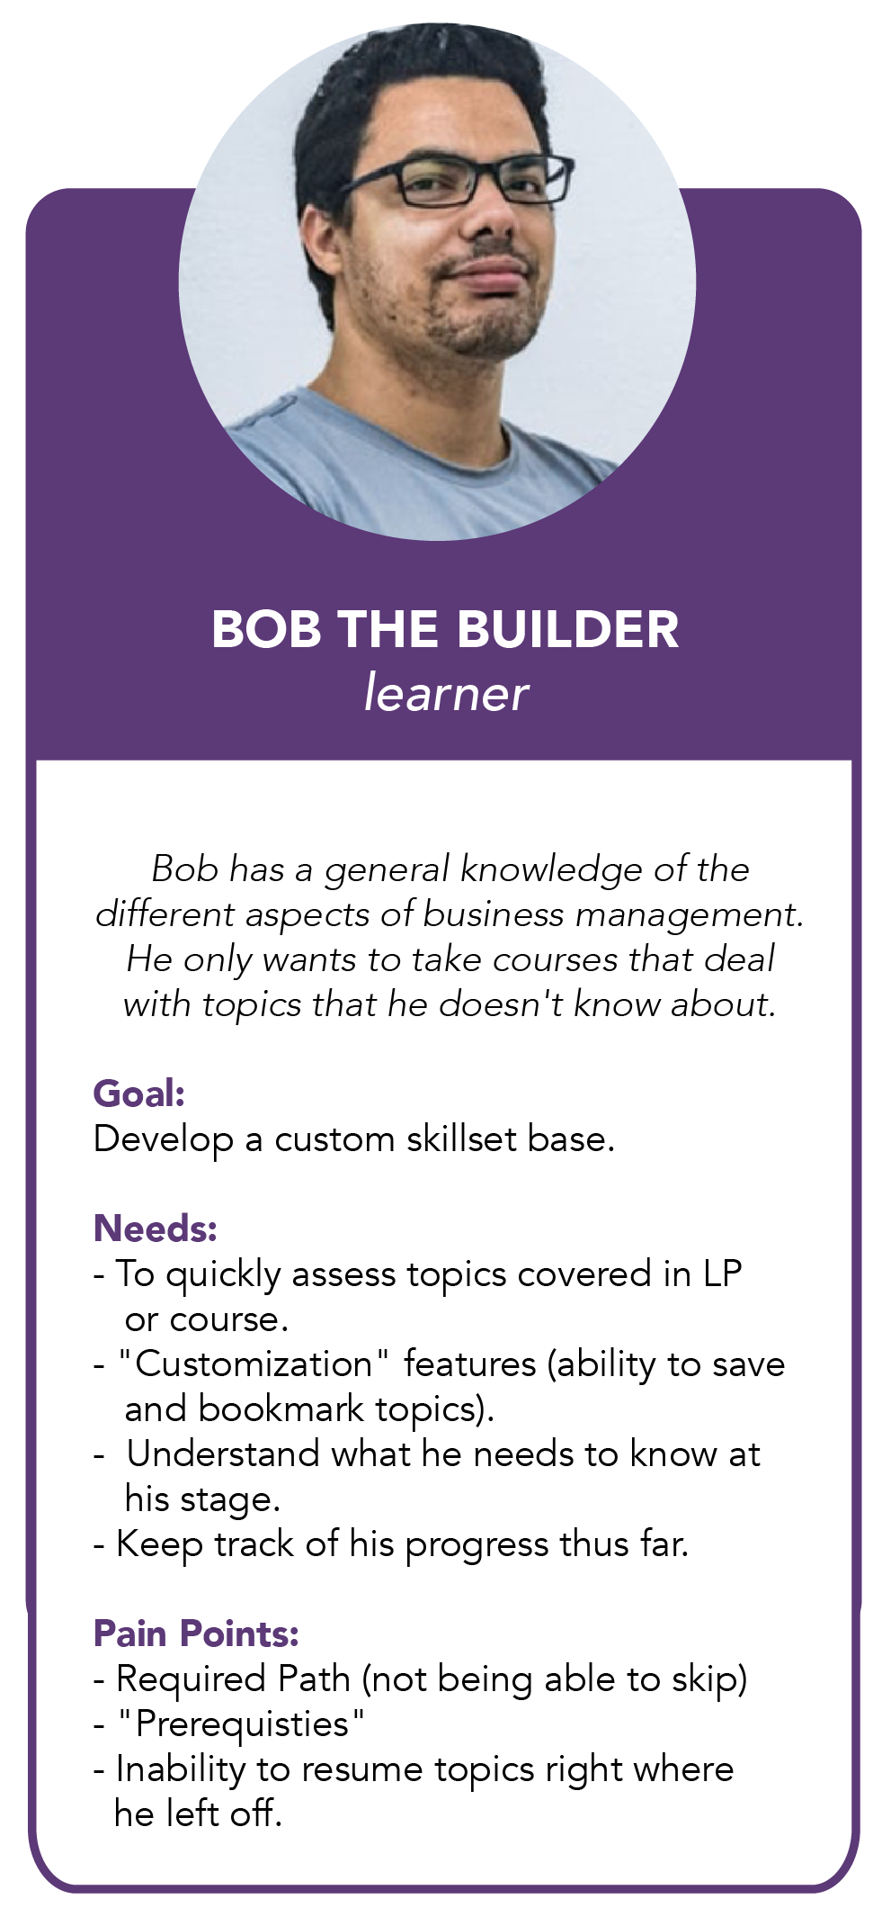
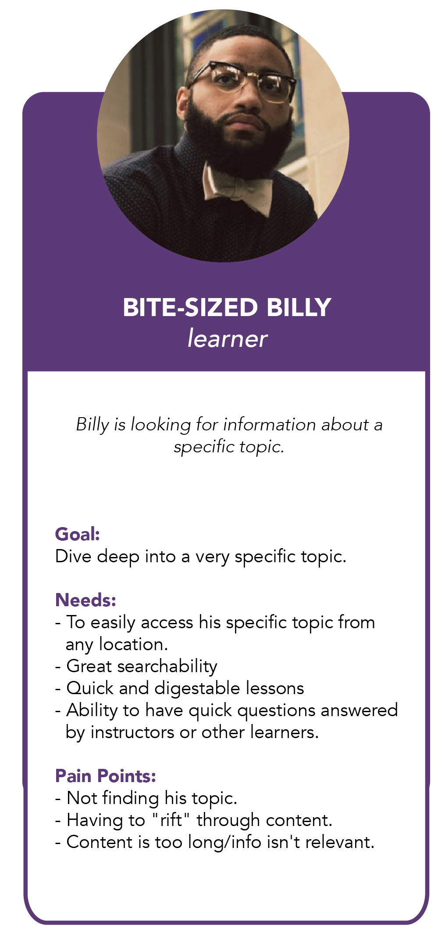
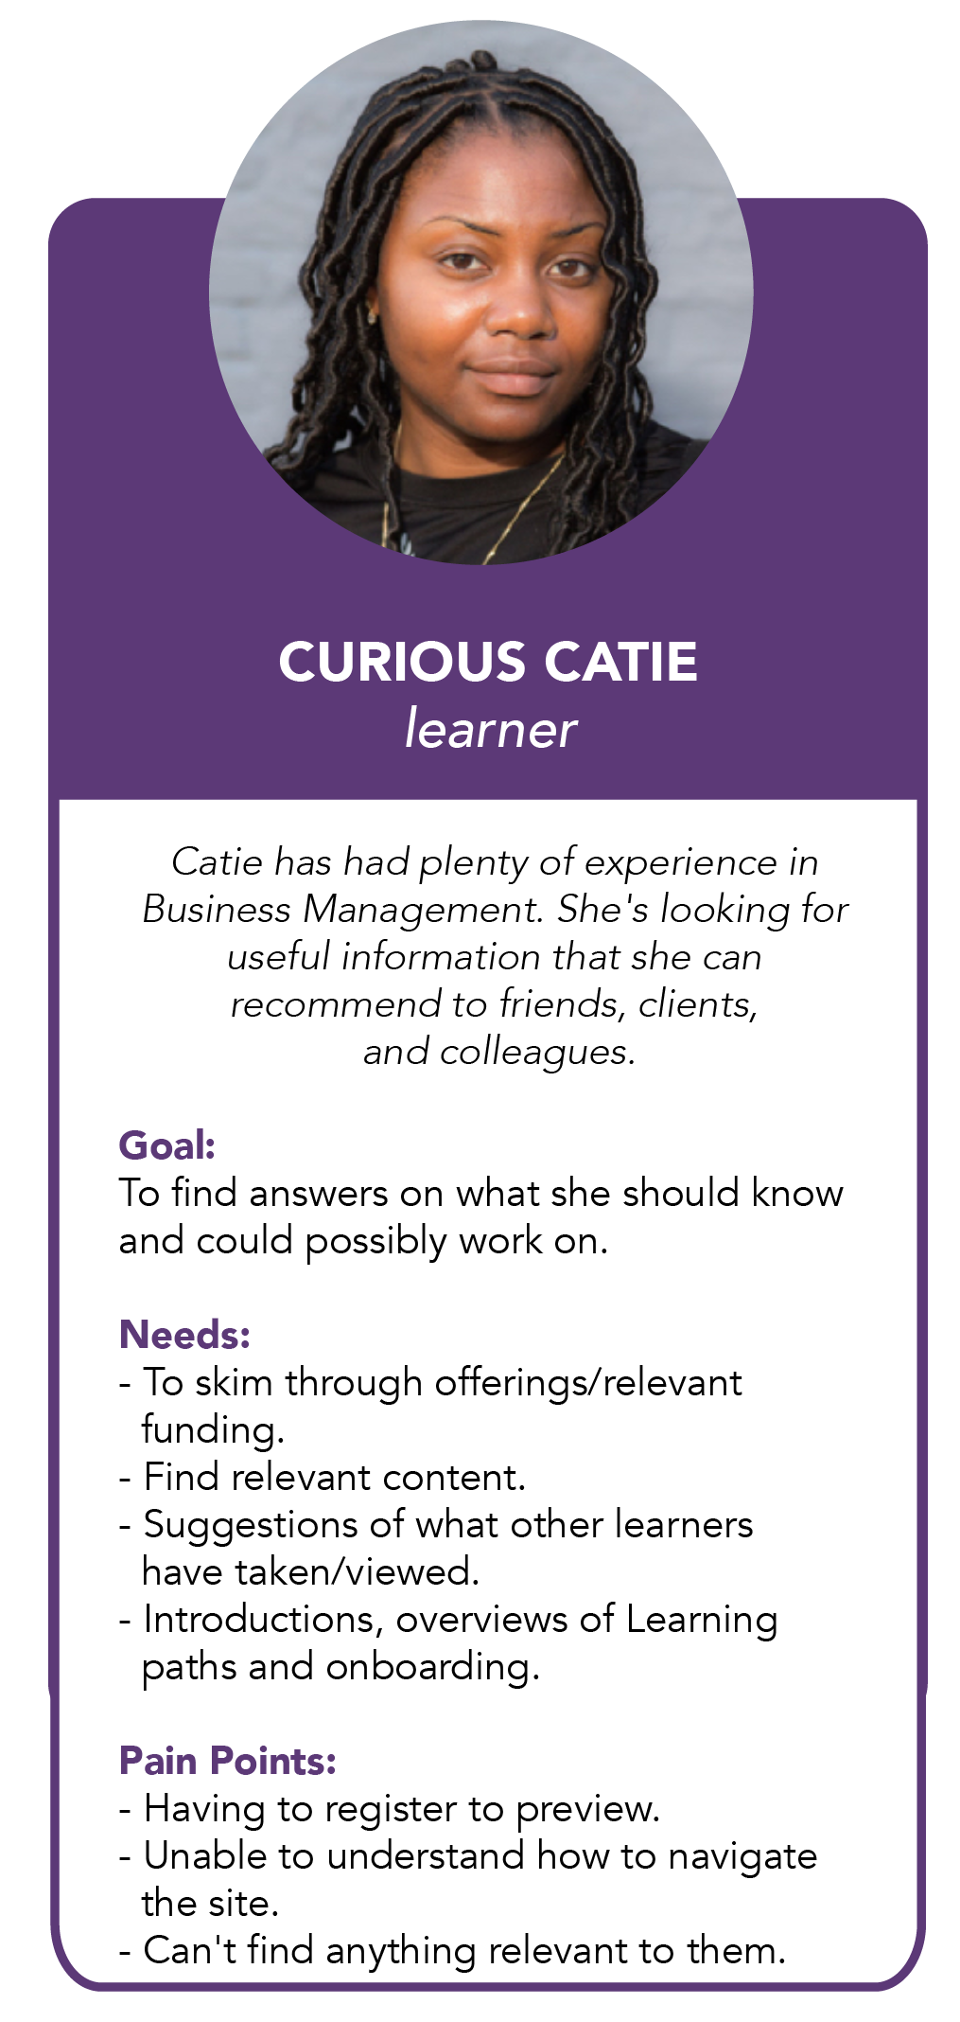
User personas

Slide 34
Interaction design
Notes:
Interaction design
Storyboards (in Kelsey’s design sprint content)
User flows (examples in Jordan’s ELI content)
Prototypes (screenshot)

Slide 35
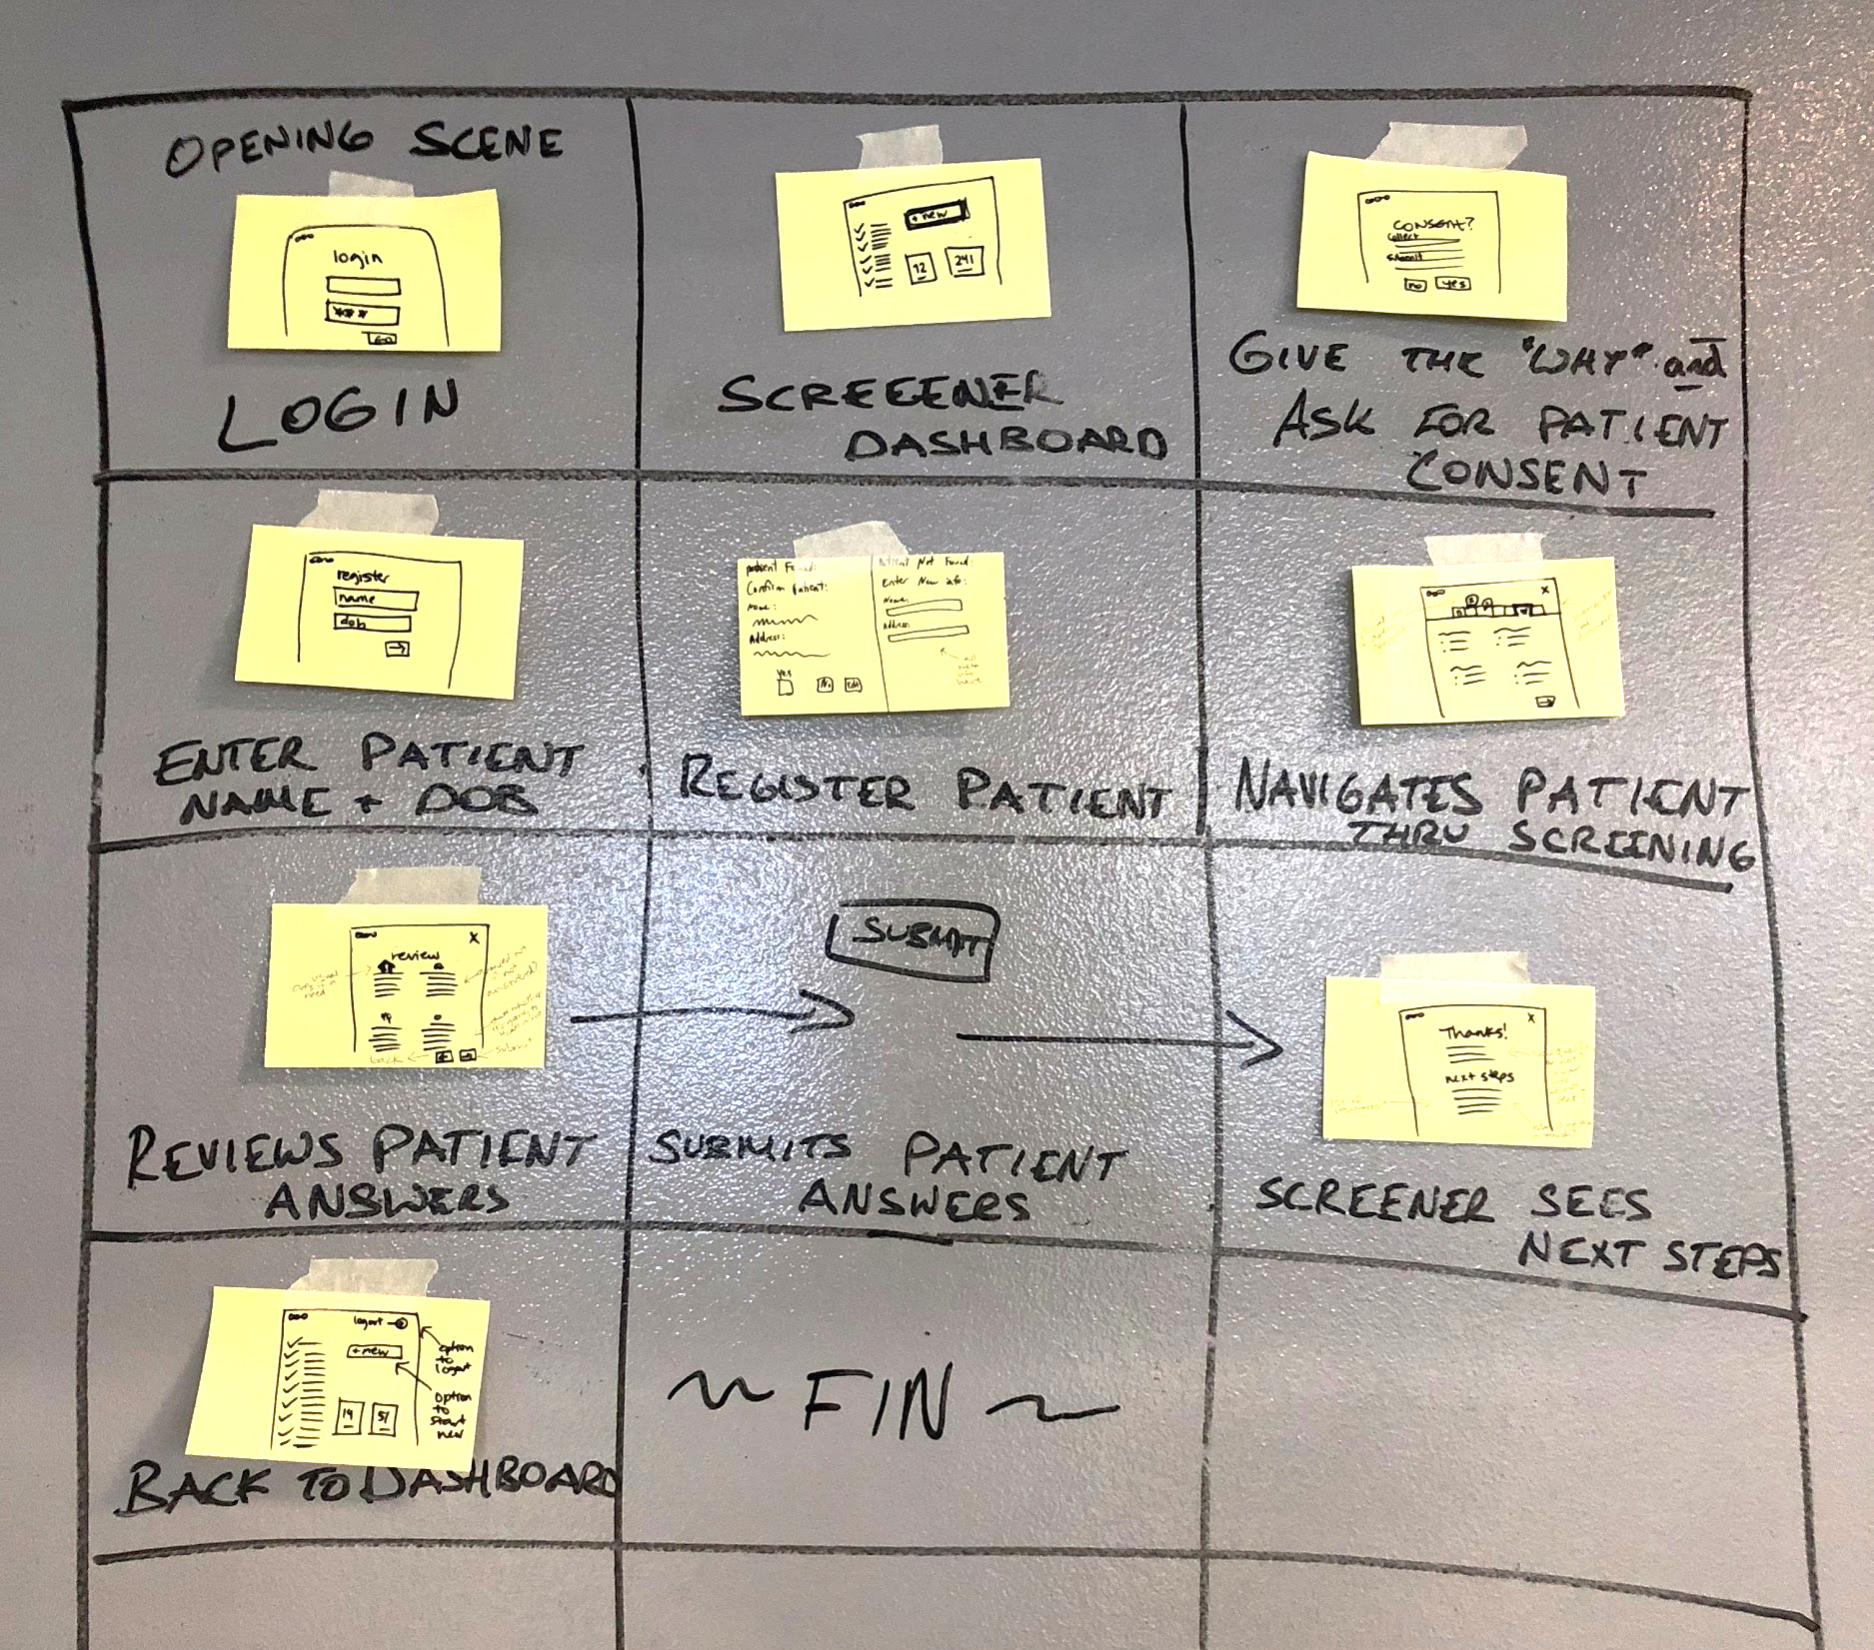
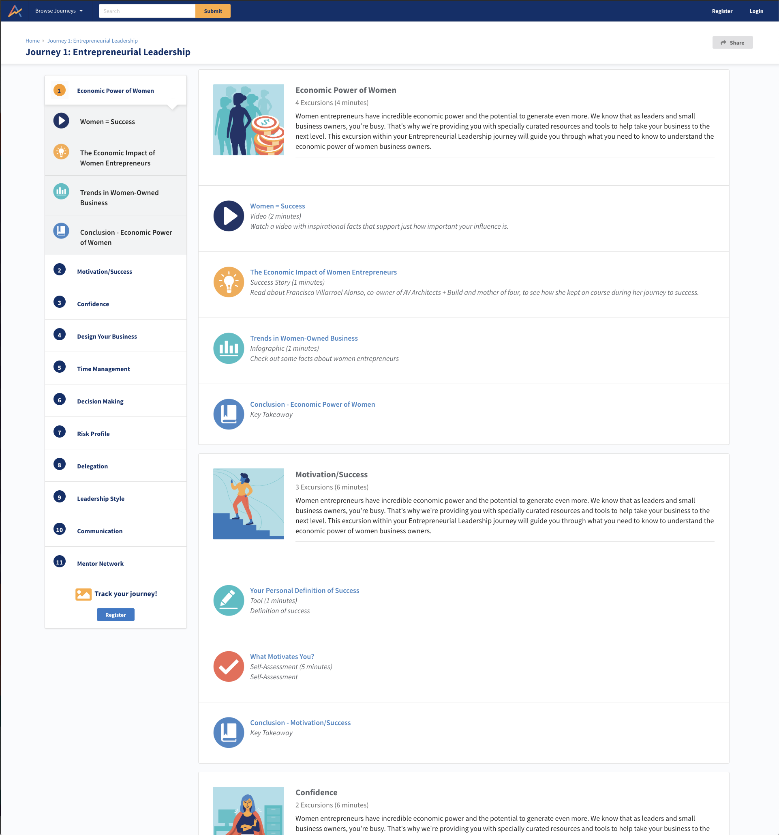
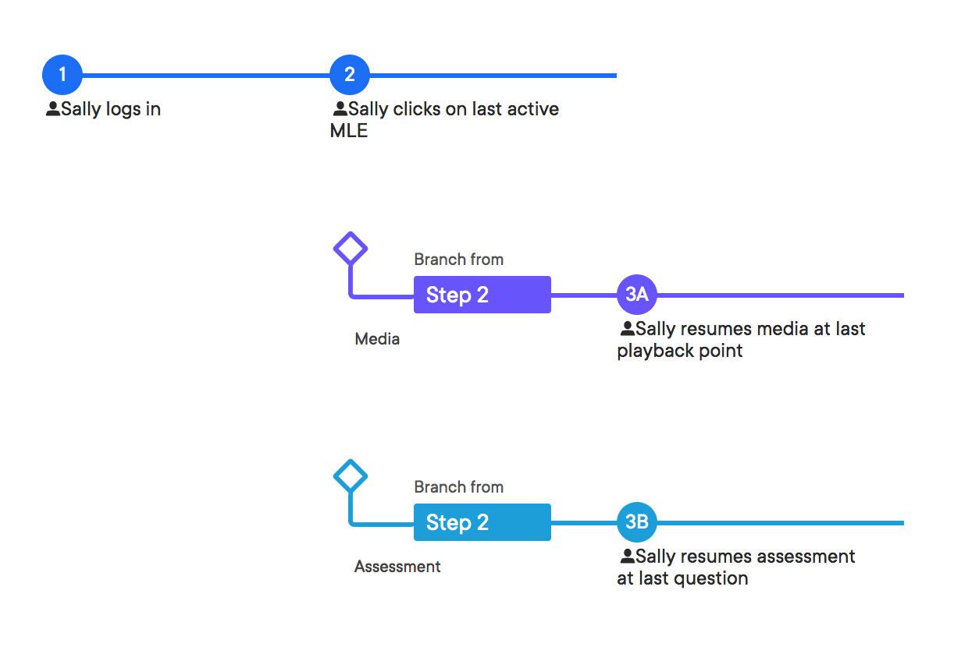
Storyboards
User flows
Prototypes

Slide 36
Interaction design process
Start with paper
Model the information that users need
Prioritize flow(s) over screens
Pick inclusive UI patterns
Design all the states (ideal, blank, error, success)
Check your solutions early with real people
Notes:
Come up with a plan. Determine the goal of the study, define what you’re trying to understand, and identify participants.
Recruit real people. Schedule participants using an automated workflow or use methods like guerrilla recruiting to get in front of users.
Do the prep work. Write a list of questions, set up any necessary technology, and (if the study is in person) prepare the setting.
Conduct the interview!
Create research artifacts based on findings. These include deliverables such as journey maps and user personas.

Slide 37

Design systems

Slide 38
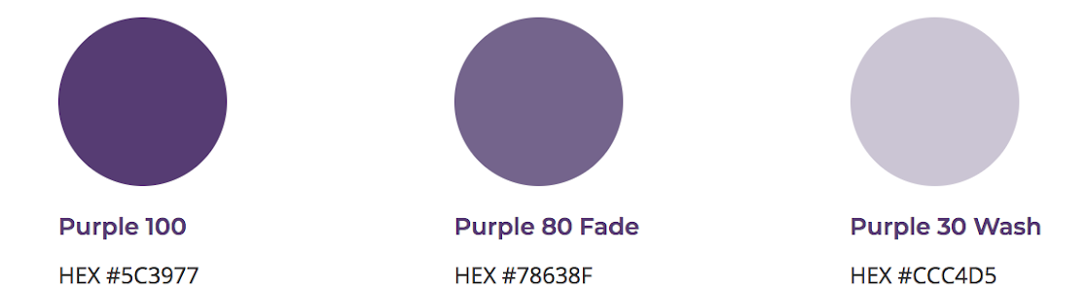




Elements of design systems
Brand and content standards
Pattern libraries
Assets and templates
Usage guidelines

